Slide 1

HubSpot – Create Deal

Slide 2
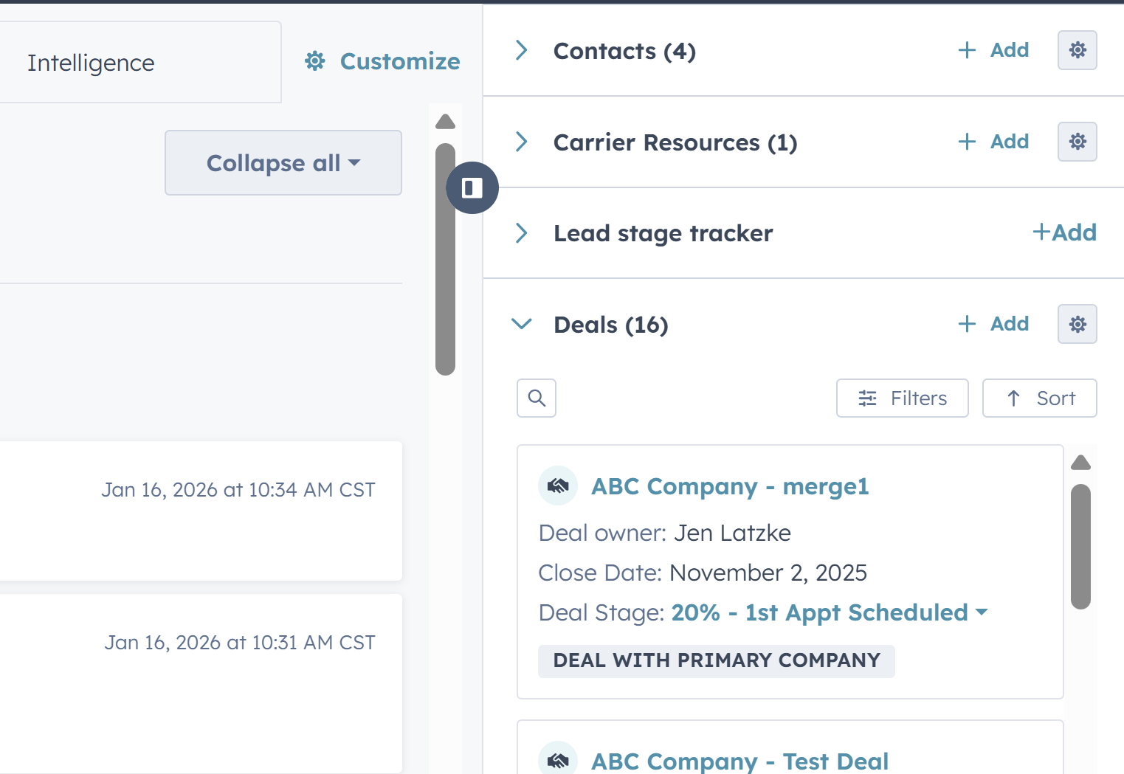
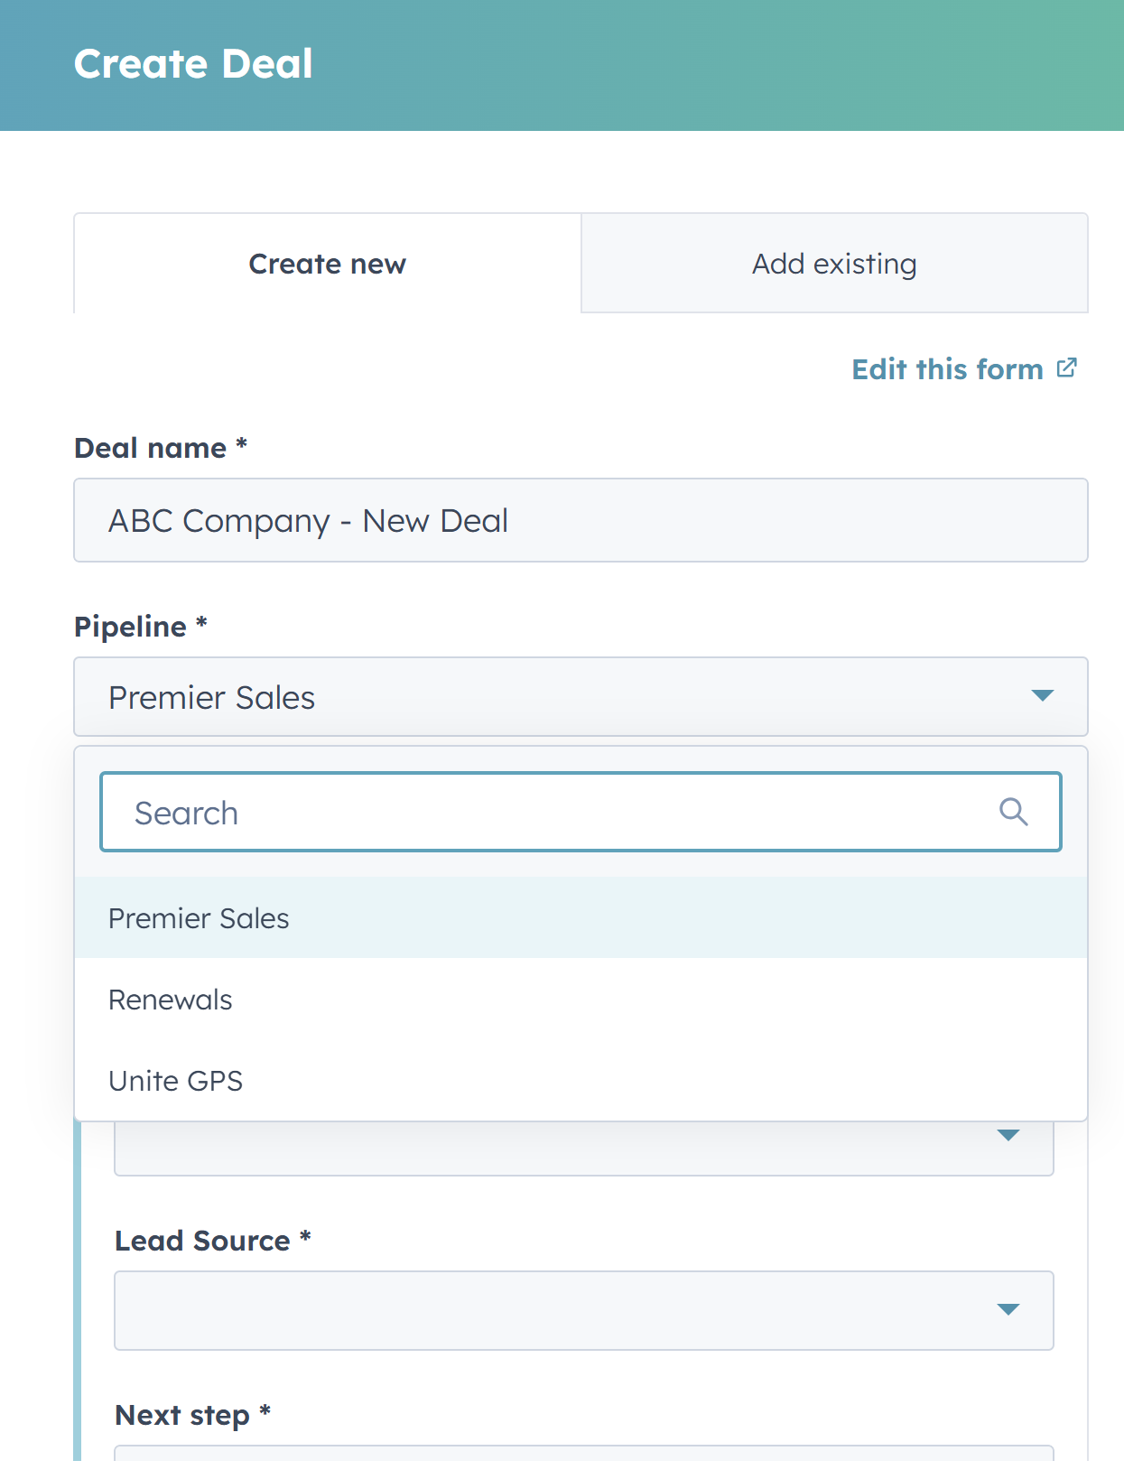
HubSpot – How to Create a Deal
1
In the Company or Contact view in you access the associated deal section on the right-hand side of the screen & select “+ Add” in blue to add a deal.
2
A deal screen will pop-up in the right-hand side of your screen

Slide 3
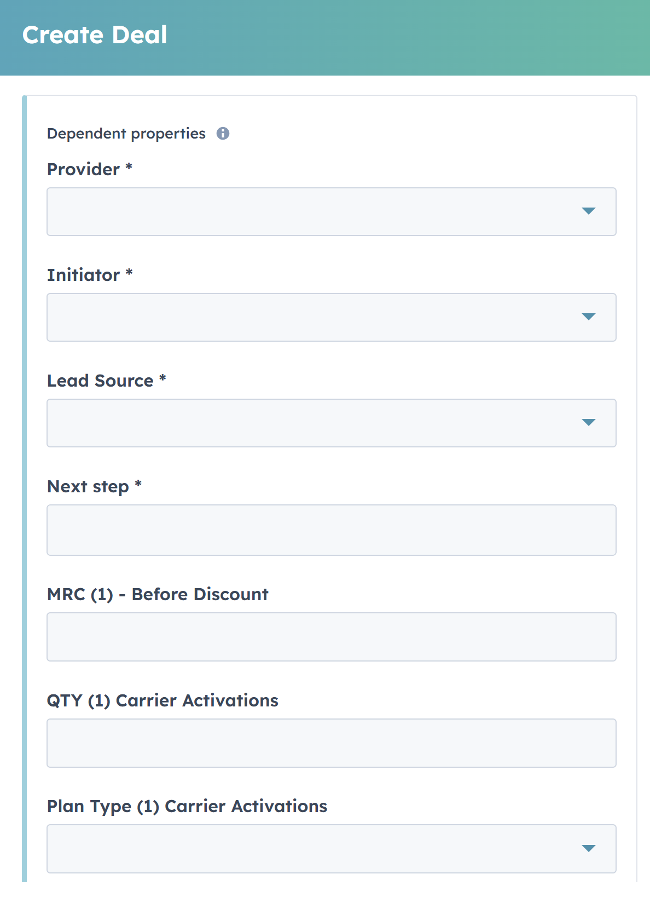
HubSpot – How to Create a Deal (Cont.)
3
Deal Name:
This is a default starting point where the Company Name is pre-populated. After the dash, “New Deal” can be removed and replaced with the quantity and type of devices so that at a glance, Deal Name will describe the full opportunity. Example: “ABC Company – 20 Crosswalk”
Pipeline:
You should ALWAYS select “Premier Sales” as the pipeline.
In this Deal creation process, you will be presented with fields to complete. Those that are mandatory are denoted with an asterisk next to the field.
4
Provider (mandatory):
If your deal has products that will be activated on T-Mobile, select “T-Mobile” as your Provider. If you are selling equipment only that will NOT be activated, you would select “None”. The other options listed include other Carriers that we may work with, albeit rarely. Lastly, “To be determined” is an option; however, it is critical that this be updated when known.
This field is critical to notify operations to DEAL REG your opportunity. Compensation is higher for Premier Initiated deals, and timely entry of DEAL REG is critical to ensure we are the first to submit the deal for T-Mobile registration.

Slide 4
HubSpot – How to Create a Deal (Cont.)
5
Initiator (mandatory):
If you originate the deal, you would select “Premier Wireless”. This is critical so that operations is notified systematically to DEAL REG with T-Mobile. If the deal is originated by “T-Mobile”, it will be your responsibility to request the PT# (Partner Teaming number) from the TMO rep you are working with. We will review later where/when that is entered.
6
Lead Source (mandatory):
You have the following options to select from – see next slide. Should you need an additional source added, please contact operations.

Slide 5
HubSpot – How to Create a Deal (Cont.)
7
Lead Source (mandatory):
You have the following options to select from. Should you need an additional source added, please contact operations.
10X Campaign
Cold Calling
Cross-sell/Upsell/Pull-through
E-rate 470
Email Campaign
Existing Customer
Manufacturer
PPC Advertising
Referral
RFP/Bid
Sell-with
STN Magazine
T-Mobile
T-Priority Campaign
Telemarketing
Trade Show
US Cellular
Webinar
Website

Slide 6
HubSpot – How to Create a Deal (Cont.)
8
Next step (mandatory):
You will be keeping this field updated as your deal moves forward. This is a multi-line text field. The correct way to update this field is to denote the date and the next steps as of that date.
For example: 1/15 Send Recommendation to customer for 10 Chromebooks
As this deal progresses, you will EDIT this field to enter the most recent update at the beginning of the text while retaining the older update for historical reference.
For example: 1/19: Review recommendation meeting scheduled for 1/21; 1/15 Send Recommendation to customer for 10 Chromebooks

Slide 7
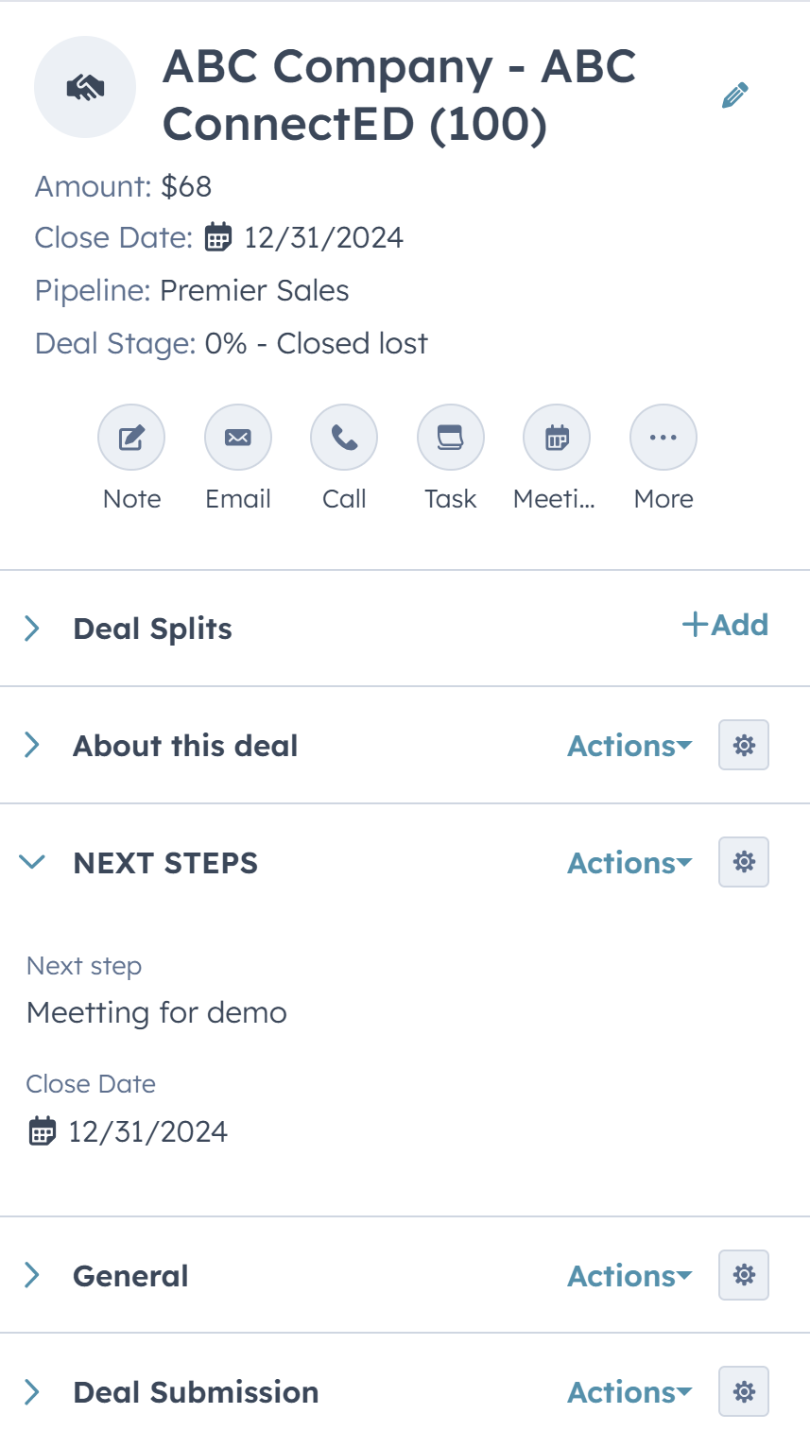
HubSpot – How to Create a Deal (Cont.)
You will continue to update this deal through the process. Each time you move the deal stage, the system will prompt you to update this field.
There is a section on the left side of the deal (when on the deal record). This section can be accessed at any time, and the Close Date can be adjusted as well.
9

Slide 8
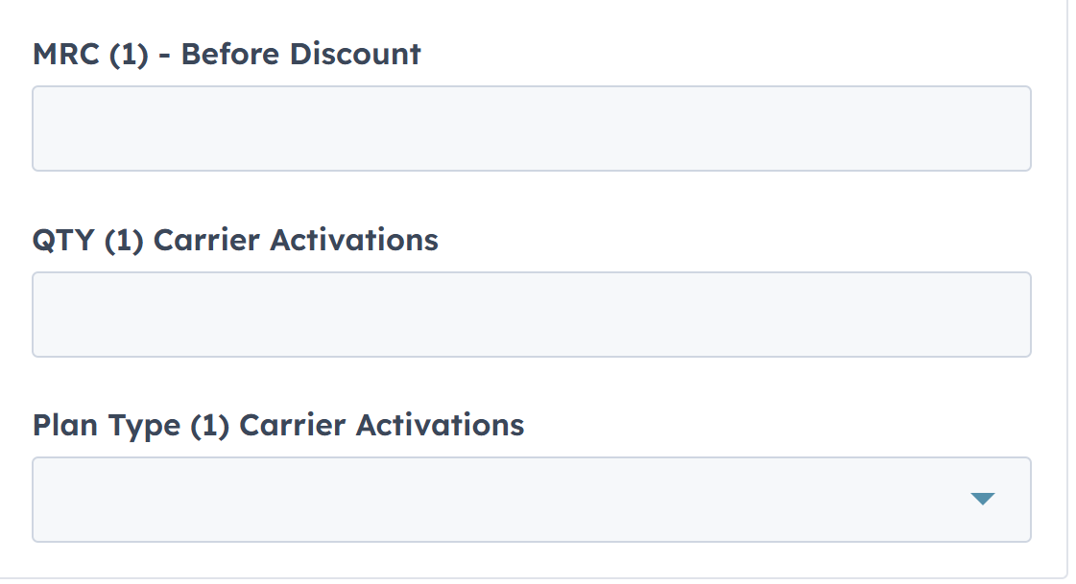
HubSpot – How to Create a Deal (Cont.)
The next set of fields are related to the activations you expect to have associated with this deal. You will enter this information, but once the deal is submitted, operations will validate this information with the actuals.
10
MRC (1) – Before Discount:
MRC – Monthly Recurring Charge. The reference to (1) is that this references the 1st set of activations that are associated with this deal. This is a number/currency formatted field. This may start out as your best guess for the activations that may happen and can be refined/updated as the deal progresses. This field is critical in order for the AMOUNT field to be calculated, representing the Gross Deal Margin associated to your deal – used for commissioning/quota calculations.
QTY (1) Carrier Activations:
This is the number of activations associated with this particular MRC for this deal. This field is critical for the AMOUNT field to be calculated.
Plan Type (1) Carrier Activations:
This is the TYPE of activation associated with this MRC/QTY. Your options are: MINT, VOICE, HIS, IOT, Other. The type of plan can also affect the AMOUNT calculation for quota attainment and commission calculation. Multipliers can vary based on the type of activation.
11
12

Slide 9
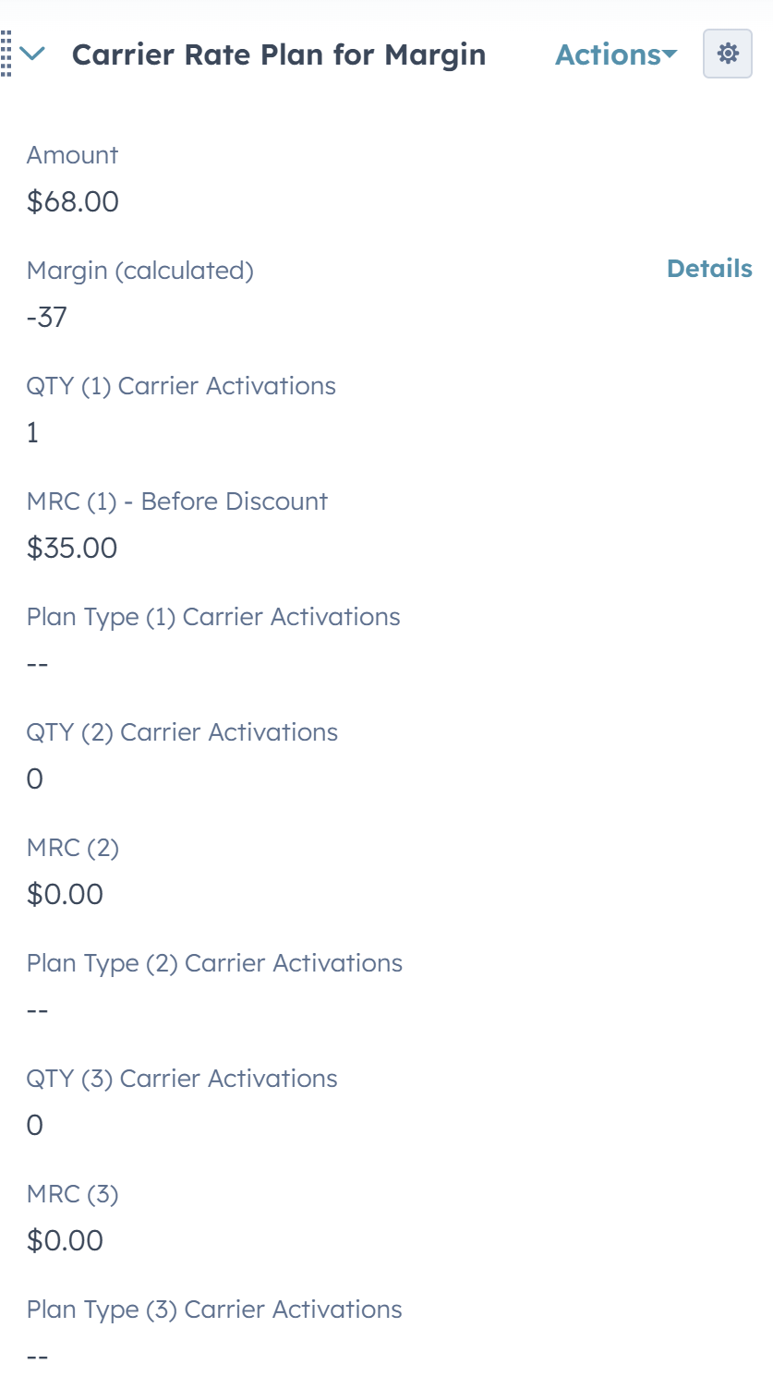
HubSpot – How to Create a Deal (Cont.)
13
All these fields can be accessed in the “Carrier Rate Plan for Margin” section located on the left side when on the deal record.
We provide an opportunity for a combination of three (3) MRC/QTY/TYPE combinations.

Slide 10
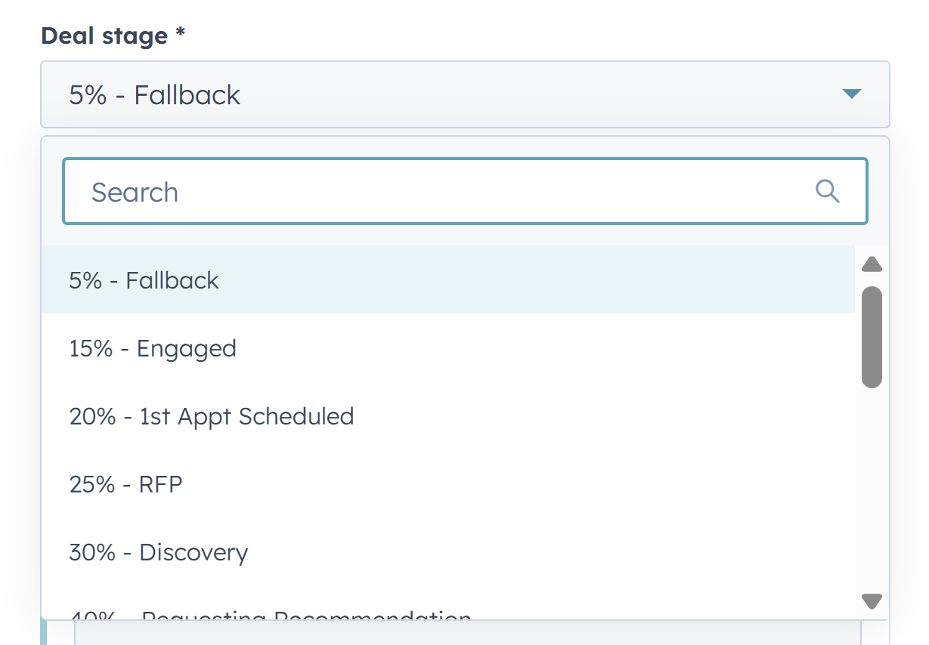
HubSpot – How to Create a Deal (Cont.)
14
Deal Stage (mandatory):
Most deals start out at “20% - 1st appt scheduled” – when cold calling and getting your first appointment. However, here is where you pick the appropriate stage depending on the status of your specific deal/opportunity.
Depending upon the deal stage you select, you will then see the series of fields associated with that stage that should be filled out. Not all fields are mandatory, in the event you do not yet know the information requested. You will have multiple opportunities to enter the non-mandatory fields as well as update the mandatory ones as the deal progresses through each stage. The next slide is a table showing the fields that will be prompted based on the stage you select, as well as presented as you update the deal stage through the deal lifecycle. If you select a stage that requires a field you have already entered, you will see it populated with information previously entered.

Slide 11
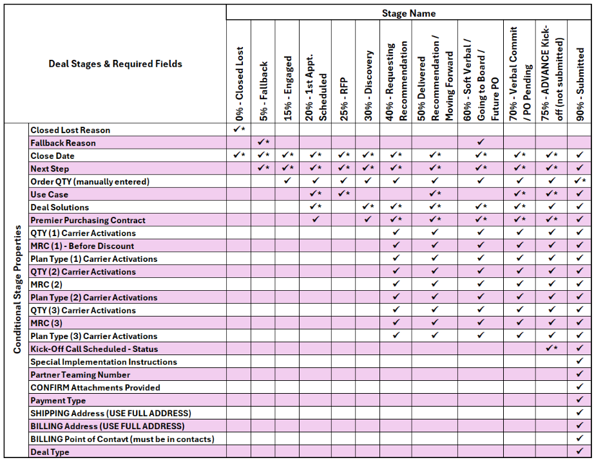
HubSpot – Deal Stages
See the next slides for a detailed breakdown for submission
Note: Cells with an asterisk are required fields at that specific stage

Slide 12
HubSpot – 90% Deal Submission
All fields below with an asterisk are required fields during this stage
HubSpot Deal Fields:
SPECIAL IMPLEMENTATION INSTRUCTIONS*
Close Date*
Next Step*
$0 quote needs quote or update (Please detail what is required) – If none – just say n/a*
Use Case – Who? Why? Hot topics & expectations…*
Partner Teaming Number*
CONFIRM Attachments Provided*
Kick-off Call Scheduled – Status*
Payment Type*
SHIPPING Address (USE FULL ADDRESS)*
BILLING Address (USE FULL ADDRESS)*
BILLING Point of Contact (must be in contacts)*
Order QTY (manually entered)*
Deal Type*
Deal Solutions*
Premier Purchasing Contract*
QTY (1) Carrier Activations*
MRC (1) – Before Discount*
Plan Type (1) Carrier Activations*
QTY (2) Carrier Activations
MRC (2)
Plan Type (2) Carrier Activations
QTY (3) Carrier Activations
MRC (3)
Plan Type (3) Carrier Activations

Slide 13
HubSpot – How to Create a Deal (Cont.)
Again, depending upon the stage selected, you are presented with various fields (both mandatory and non-mandatory) to fill in. Let’s go over the different fields that you will encounter for reference and explanation.
Close Date:
This is the date that you expect to “Submit” the order. This date is also the date that will be aligned with the “Sales Order Accepted Date”. The “Sales Order Accepted Date” is completed by Operations when you move the deal to Submission. Once all required information has been provided to submit the order, operations will move the deal to 95% and set both the “Sales Order Accepted Date” and the “Close Date” to match the date it was moved to 95%. This will then be the date your order is counted toward quota attainment. Refer to your commission plan to understand when the order is eligible for commission payout and timing.
Use Case – Who? Why? Hot topics & expectations:
This is a multi-line free-form text field. Briefly describe who the customer is, why they are buying, and what problem we are solving for them. Include any key drivers, hot topics, or expectations (e.g., compliance needs, funding deadlines, security concerns, scalability, or service-level expectations) that are influencing the deal. Continue to update this field as the deal matures through the process. Implementation will review this field so they understand the use case when project managing the implementation and delivery of the order.
15
16

Slide 14
HubSpot – How to Create a Deal (Cont.)
17
Partner Teaming Number:
This is a critical field for Premier to sell T-Mobile services and get commissioned.
If your deal is T-Mobile-initiated, this will be a number that you will ask your T-Mobile rep to provide to you. It is important that you be provided this number, as this is systematically how the T-Mobile rep assigns the deal to Premier Wireless for processing and commissioning.
If your deal is Premier Initiated, your deal will need to have been ‘deal reg’d’ with T-Mobile. Deal Registration is performed by Sales Support. The system notifies us when a deal has been created and is in a deal stage of 20% or higher – and the Initiated field is set to ‘Premier Wireless’ – and lastly, the Provider field is set to “T-Mobile”. If you are resurrecting an older deal or if you were transitioning deals that were created by other reps, please be sure to check that these fields are filled out correctly. If you do not have a Partner Teaming number on your deal, feel free to reach out to Sales Support.
IMPORTANT: If you have a deal that you may have just entered and you feel it is Urgent and timely that it be entered for deal registration, please submit a ticket to sales operations. We will stop what we are doing and enter it right away.
Order QTY (manually entered):
This field is a manual reference used for reporting. In various stages of the deal, you may not have enough information to add product lines that will be used to determine the size of the deal. We use this field to confirm the quantity as it progresses through the sales cycle.
18

Slide 15
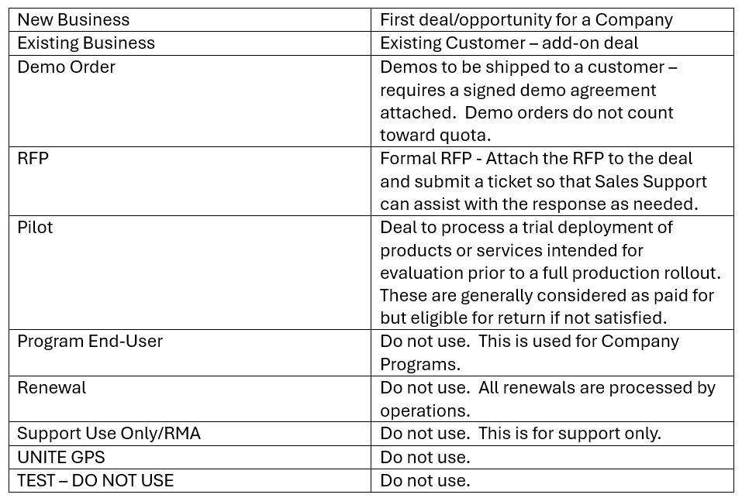
HubSpot – How to Create a Deal (Cont.)
Deal Type: Below are your choices for this field:
19

Slide 16
HubSpot – Field Definitions
20
Deal Solutions:
This will be the high-level category of the products you are proposing in this opportunity. This is a multi-select field so that if you are pitching multiple product lines, please check all that apply. Below are examples of the Solution options you have – there are subject to change as products evolve:
Activation Only
Body Cam
Camera – Bus
Camera – Security
Camera – Vehicle
Camera
Chromebook
Communication Hub
ConnectED Bus
CPR3
CPR3 Tablet
CrisisGo
Crosswalk
DialPad
GeoTab
Go Kit
GPO – Contract
Hotspot
HIS
IOT Solution
Laptop
LPR
MDM
Multi-Line
Network-in-a-Box
Other
POTS replacement
Push to Talk
Renewal
Router
Rugged Laptop
Special Products
Tablet (non-CPR3)
TO BE DETERMINED
TotSpot/SilverSpot/Smartbook
Traditional Cellular
Transit
Warranty
Wi-Fi
Wi-Fi – In Building
Wi-Fi – Public
ZeroEyes

Slide 17
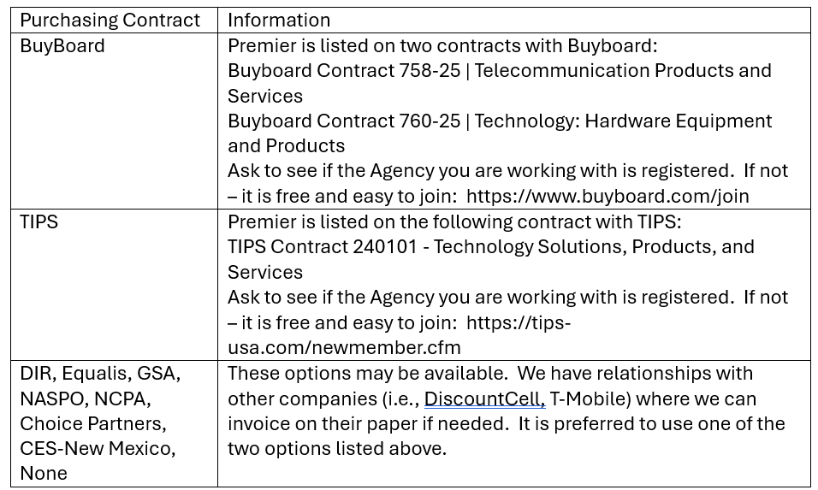
HubSpot – Field Definitions (Cont.)
21
Premier Purchasing Contract:
Government will require orders/bids to either go out for RFP/Bid to comply with their requirements or they can purchase through a competitively solicited contract vehicle administered by a governmental or public-sector organization that enables eligible government, education, and nonprofit entities to procure goods and services under pre-negotiated terms without conducting a separate, standalone procurement. Below are the items that can be selected and the information related:

Slide 18
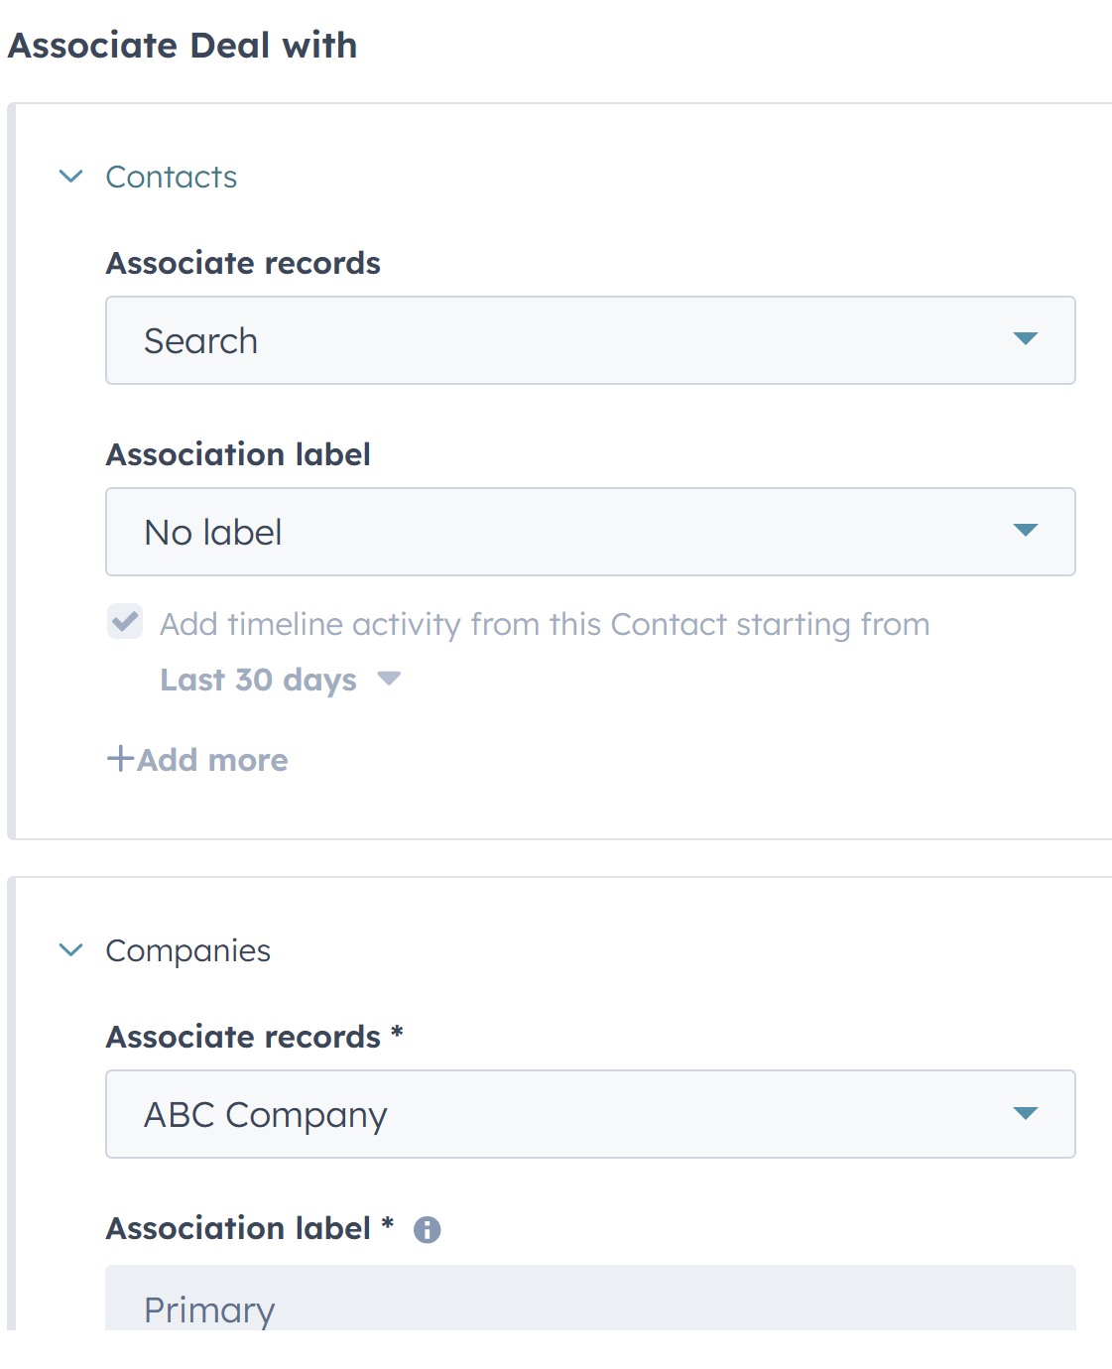
HubSpot – Field Definitions (Cont.)
22
At the bottom of the CREATE DEAL FORM – you have the opportunity to associate the deal with the appropriate Contact and Company (if not already associated). This is not a mandatory step however, it is requested to have the appropriate Contact associated as well as the deal.
This Contact information is leveraged throughout the process. Through Deal Registration, Recommendation development, order submission and implementation, we rely upon this information to complete the required work/steps on the operations side. It is NOT currently required systematically, only because we understand that you may need to create a deal record before you know who the contact is.
Lastly, in the DEAL CREATION stage, you can add line items at the bottom of the CREATE CARD. However, you will find it easier to add products/line to your deal from the Deal Record itself rather than the CREATE CARD. In the Deal record, you can access the LINES section on the right side of the screen to add products. If you are not sure what products to add or if you are sourcing products unique to your deal, when you submit a ticket for a Recommendation, Sales Support we ensure the correct products and pricing are logged onto the deal.
23

Slide 19
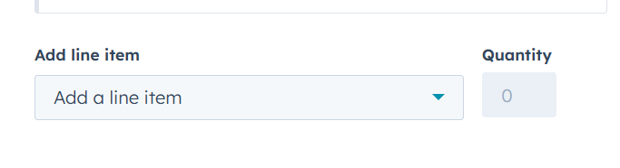
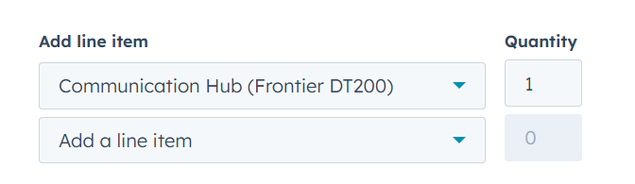
HubSpot – Field Definitions (Cont.)
24
Lastly, in the DEAL CREATION stage, you can add line items at the bottom of the CREATE CARD. However, you will find it easier to add products/line to your deal from the Deal Record itself rather than the CREATE CARD. In the Deal record, you can access the LINES section on the right side of the screen to add products. If you are not sure what products to add or if you are sourcing products unique to your deal, when you submit a ticket for a Recommendation, Sales Support we ensure the correct products and pricing are logged onto the deal.

Slide 20
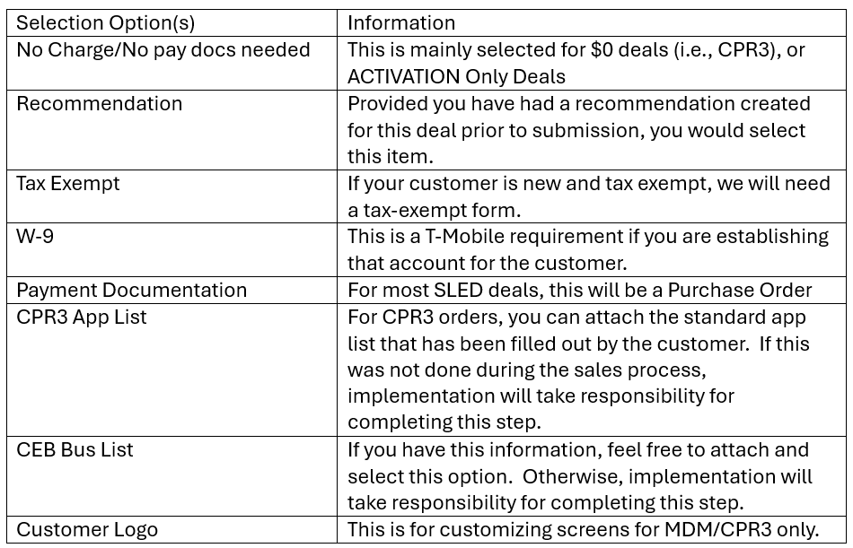
HubSpot – Field Definitions (Cont.)
When your deal is ready to Submit (move to Deal Stage – 90%), your pop-up with the required fields will be presented. Other than the fields mentioned throughout this instruction, which should be review and updated as needed, you will notice a few new pieces of information needed to submit your deal. See below:
SPECIAL IMPLEMENTATION INSTRUCTIONS:
This is a free-form multi-line text field where you will use this opportunity to provide any/all information you want to communicate to Implementation and Deployment as we process your deal.
$0 quote needs quote or update (Please detail what is required) – If none, just say n/a: This was most commonly used for CPR3 and our $0 cost bundles. We did not want the reps to have to take two steps to close a deal, for example, (Recommendation Request & Order Submission). We would either create the Recommendation at that point in the process and provide a notification to the sales rep when ready, or we can update the quantity so that the deal reflects the correct quantity.
26
CONFIRM Attachments Provided:
This is a multi-select field that is mandatory. Please select all that apply:
25

Slide 21
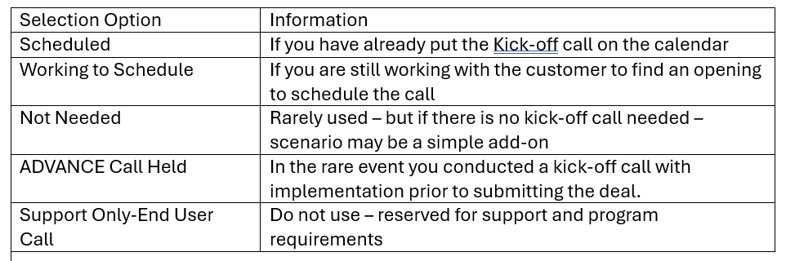
HubSpot – Field Definitions (Cont.)
27
Kick-off Call Scheduled – Status:
Whenever possible, we ask that the sales rep schedule the Implementation Kick-Off Call. Given the established relationship between the sales rep and the customer, it would be a warmer hand-off to the Implementation Team. When this call takes place, the sales rep only need join for the first few minutes to do introductions. At that point you are welcome to log-off of the call and leave it in the hands of the implementation team to walk the customer through the kick-off call.

Slide 22
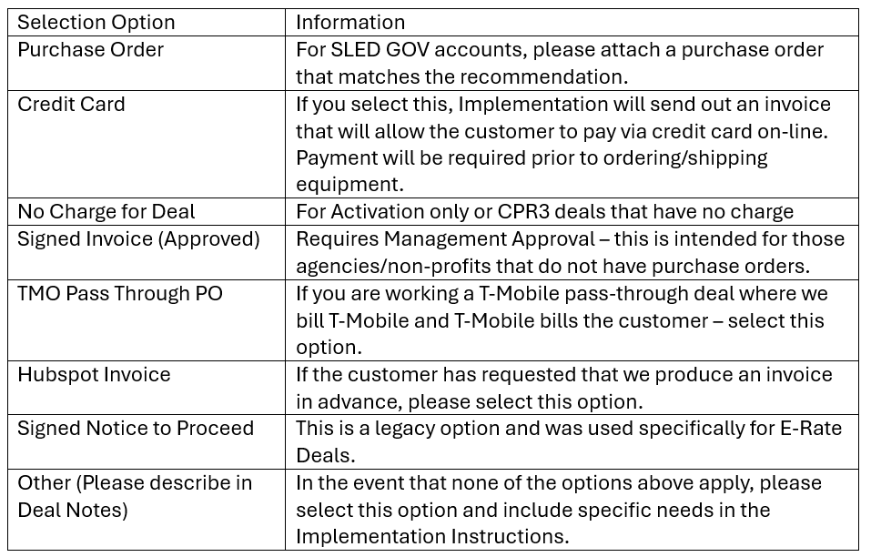
HubSpot – Field Definitions (Cont.)
28
Payment Type:
This is a drop-down select field that is mandatory. Below are the options and related information:

Slide 23
HubSpot – Field Definitions (Cont.)
29
SHIPPING Address (USE FULL ADDRESS):
This is a free-form text multi-line field that is mandatory. The sales rep should confirm this with the customer. We do not want to assume that any address associated with the Company or the Contact is the address where the customer wants their order shipped to.
BILLING Address (USE FULL ADDRESS):
This is a free-form text multi-line field that is mandatory. The sales rep should confirm this with the customer. We do not want to assume that any address associated with the Company or the Contact is the correct billing address.
BILLING Point of Contact (must be in contacts):
This is a free-form text field that is mandatory. Please let us know which Contact on the account is the Billing point of contact.
30
31

