Slide 1

HubSpot – Overview

Slide 2
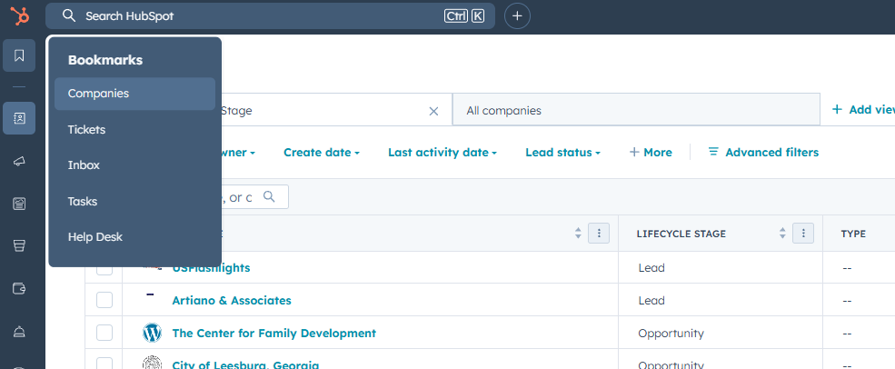
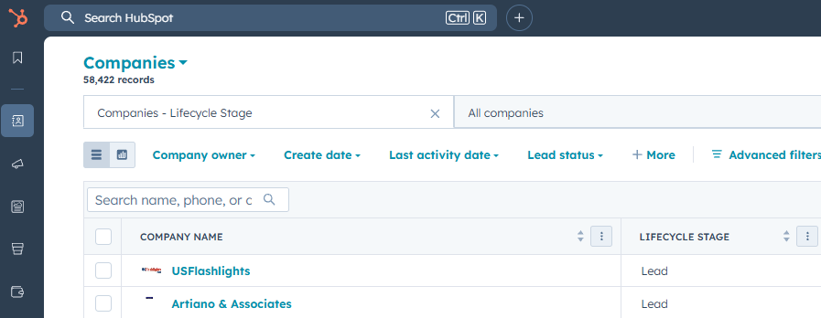
HubSpot - High-level Overview
Customizable Bookmarks
Main “Search” bar

Slide 3
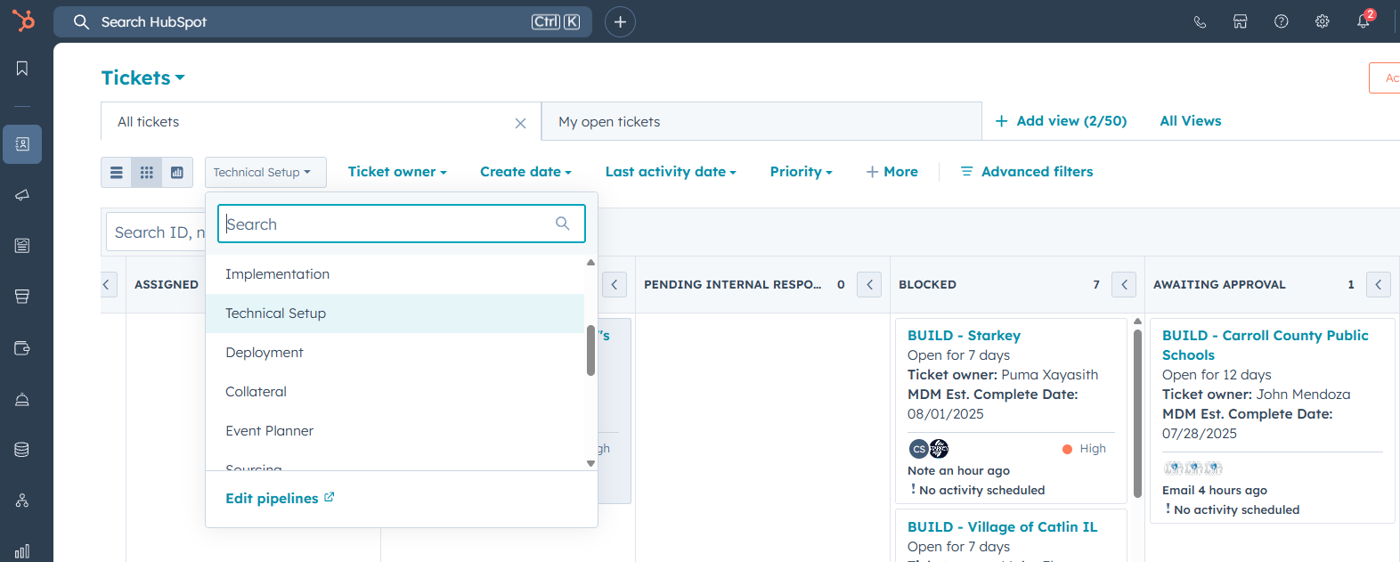
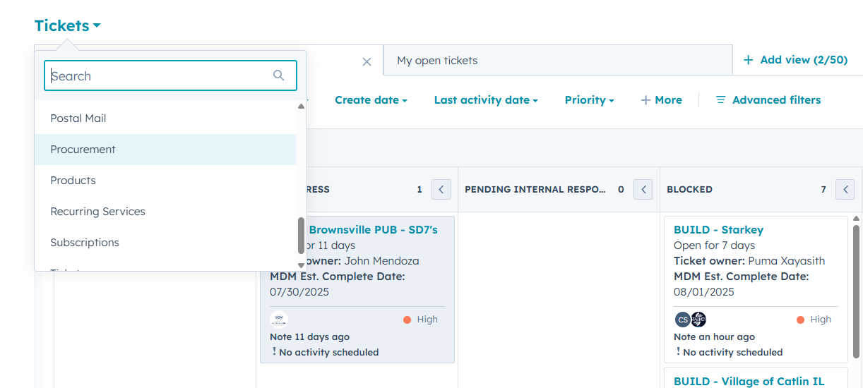
HubSpot - High-level Overview
Updating Pipeline View
Updating Custom Object View

Slide 4
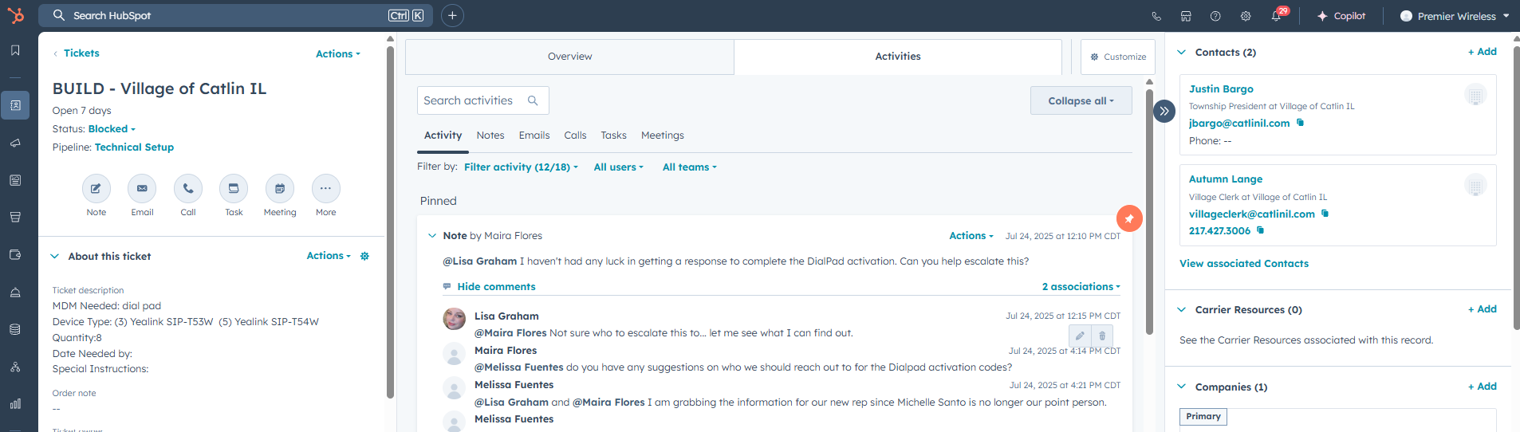
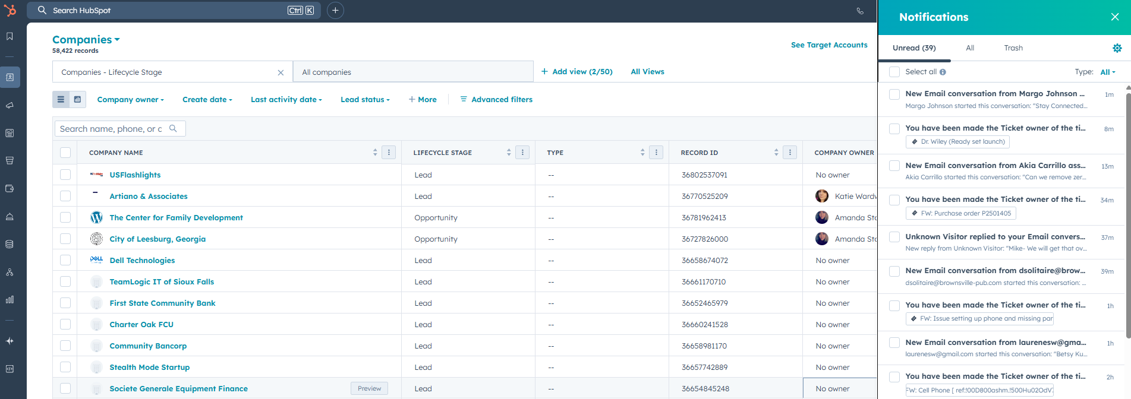
HubSpot - High-level Overview
Notifications Bell
Notifications View

Slide 5
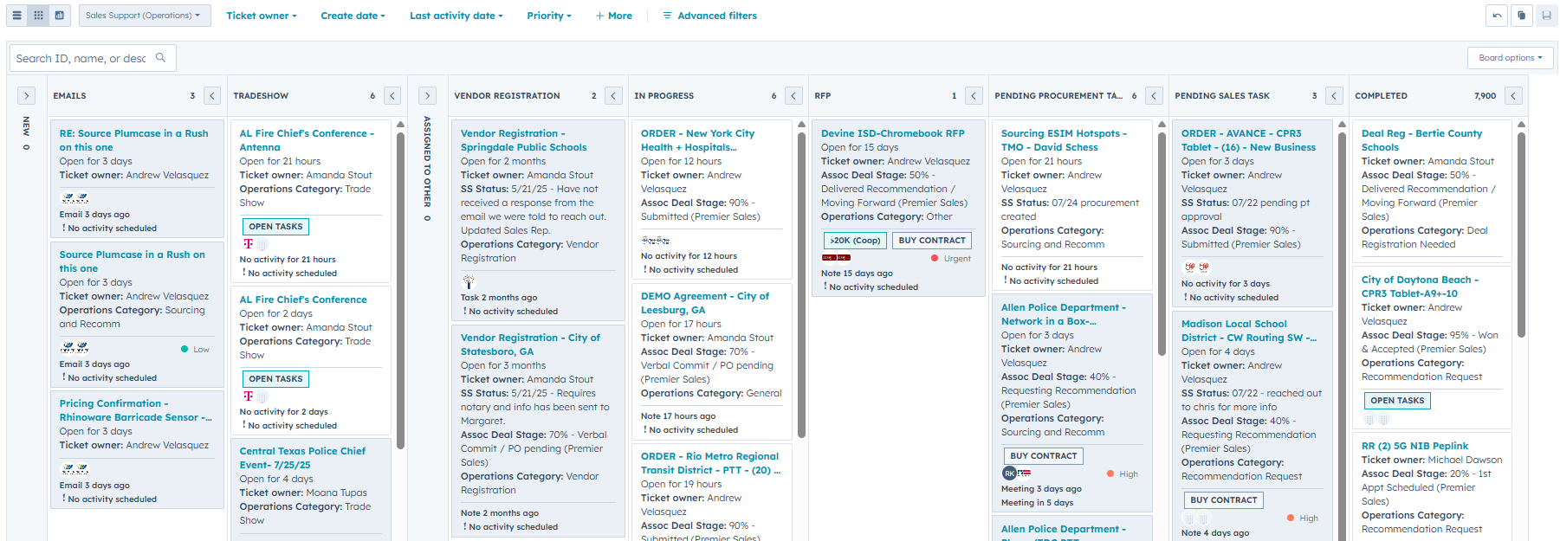
HubSpot – Pipelines
Pipeline View
Customizable View
Quick Search
Pipeline Stages
Collapsable View
High-level Ticket Information & Tags

Slide 6
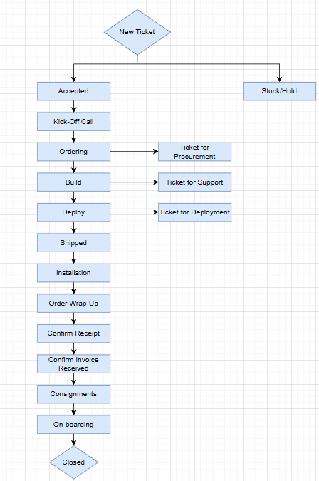
HubSpot – General Order Flow
Once “Deal” is moved to 95%, a new Implementation Ticket is auto-created
This ticket stays with the Implementation Manager and is moved between different status stages until Closed
Once the order is removed from “Stuck/Hold” it would follow the general “Accepted” order flow
Separate tickets are created for other departments to manage those tasks separately

