Slide 1
Voice
CONFIDENTIAL

Slide 2
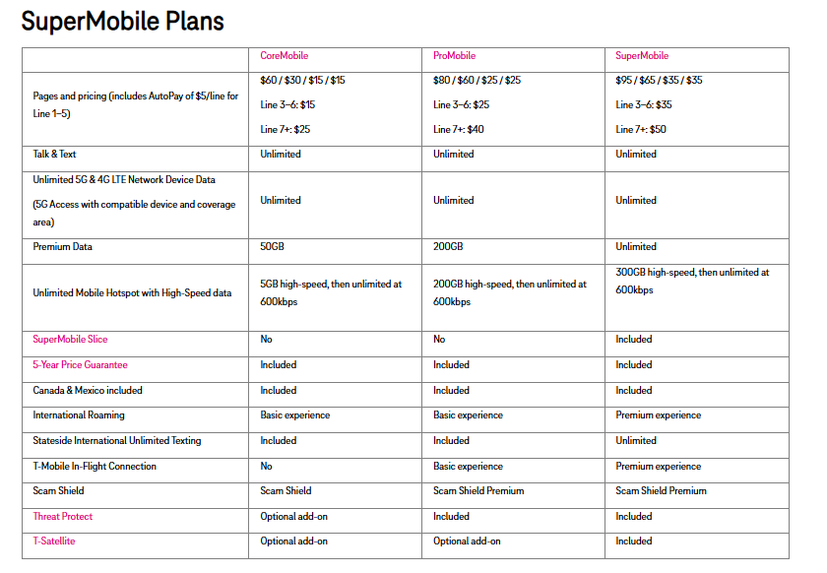
T-Mobile SuperMobile Plans
CONFIDENTIAL

Slide 3

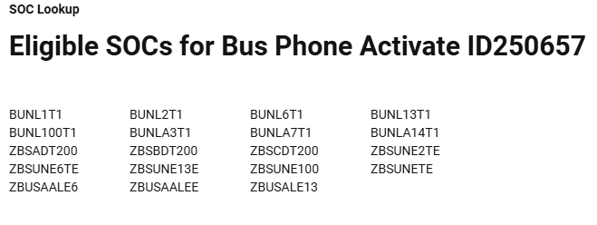
T-Mobile Voice Promos
CONFIDENTIAL

Slide 4
Business Internet
CONFIDENTIAL

Slide 5
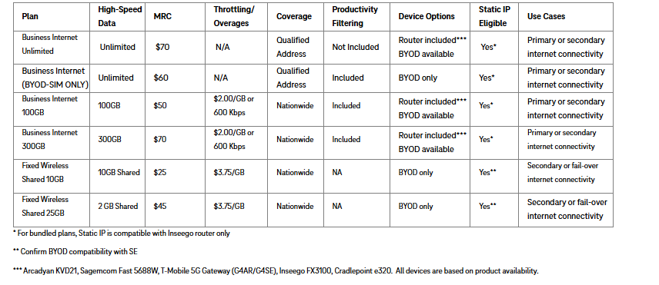
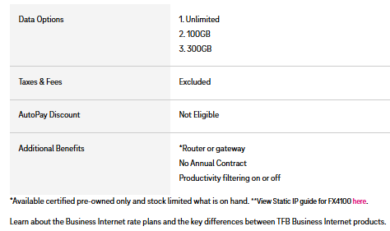
T-Mobile Business Internet Plans
Business Internet
CONFIDENTIAL

Slide 6
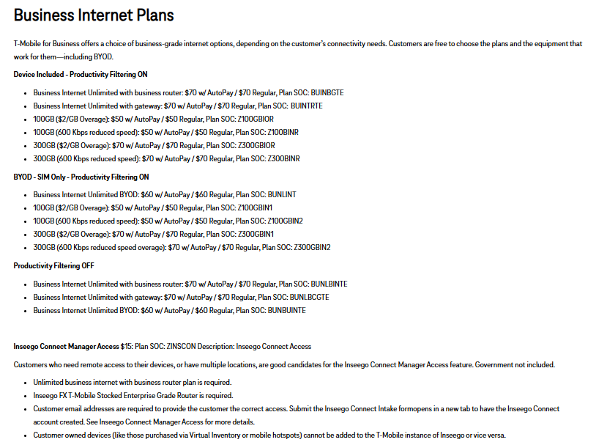
T-Mobile Business Internet Plans
Business Internet
CONFIDENTIAL

Slide 7

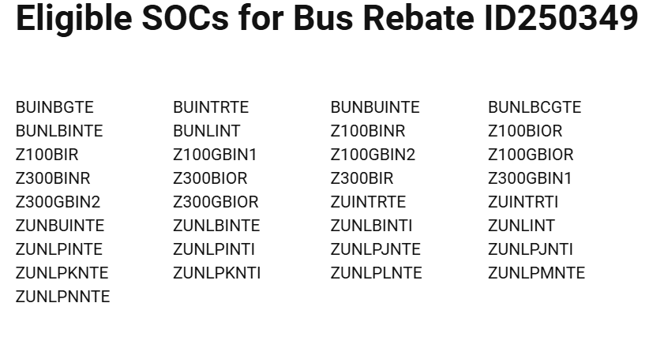

T-Mobile Business Internet Promos
SMB/VBS/Enterprise
CONFIDENTIAL

Slide 8

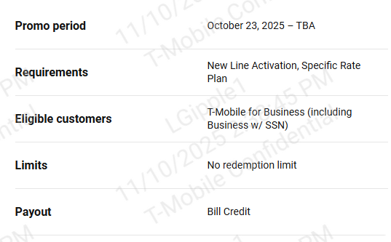
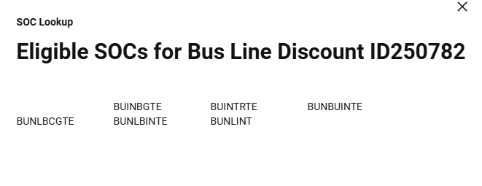
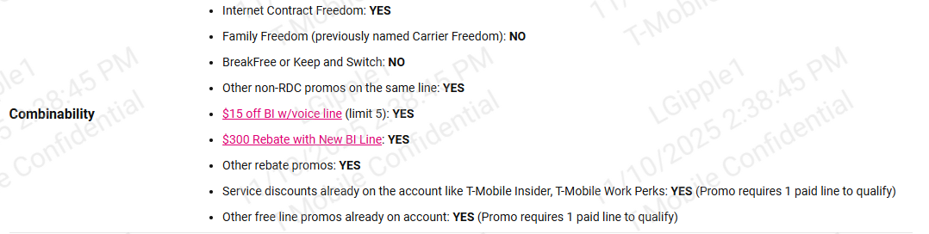
T-Mobile Business Internet Promos
CONFIDENTIAL

Slide 9

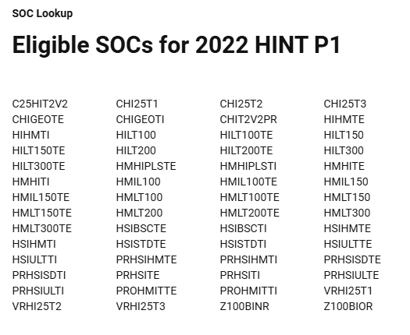
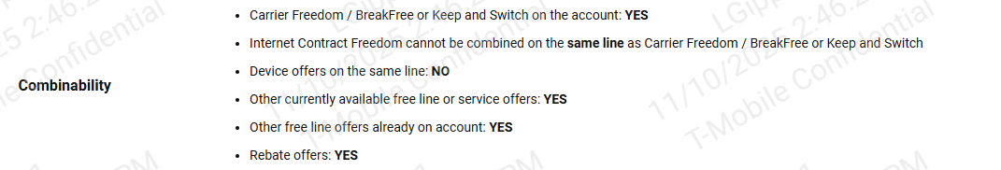
T-Mobile Business Internet Promos
CONFIDENTIAL

Slide 10

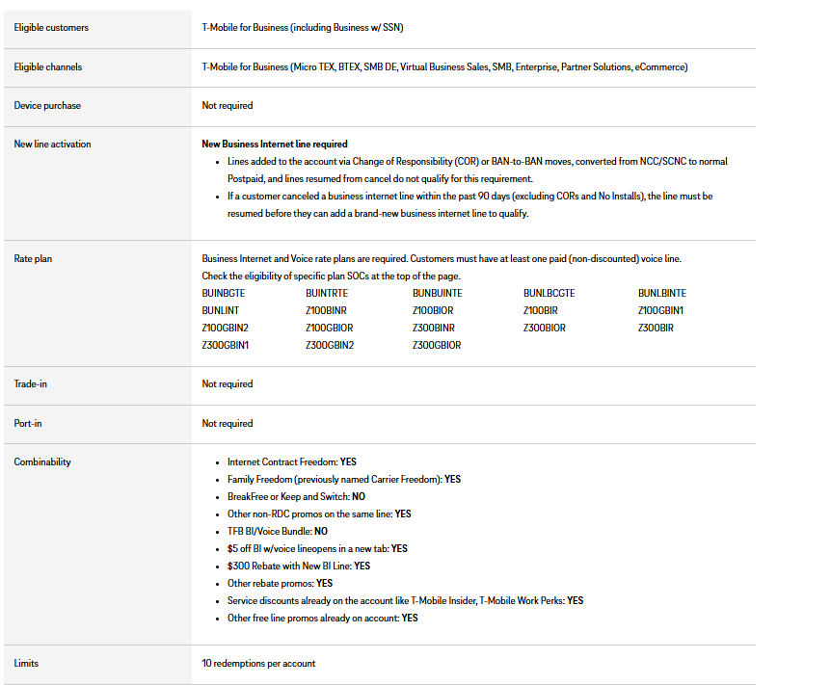
T-Mobile Business Internet Promos
CONFIDENTIAL

Slide 11
Mobile Internet
CONFIDENTIAL

Slide 12
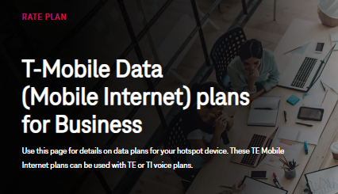
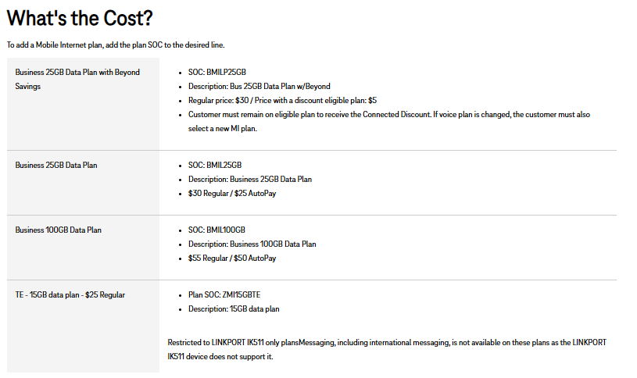
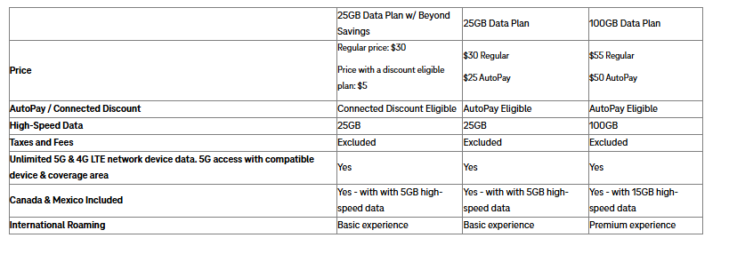
T-Mobile Mobile Internet - Hotspots
CONFIDENTIAL

Slide 13
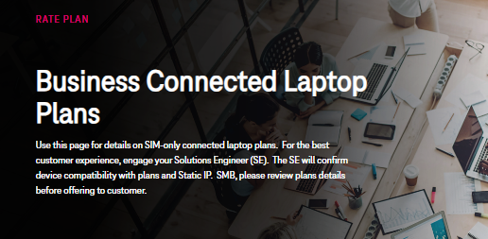
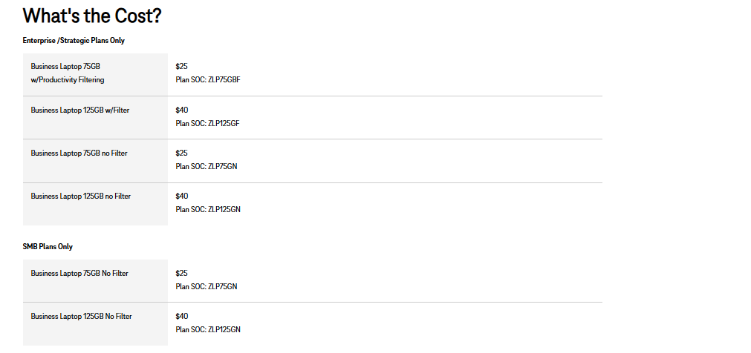
T-Mobile Mobile Internet – Connected Laptops
CONFIDENTIAL

Slide 14
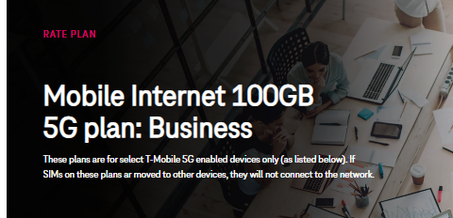
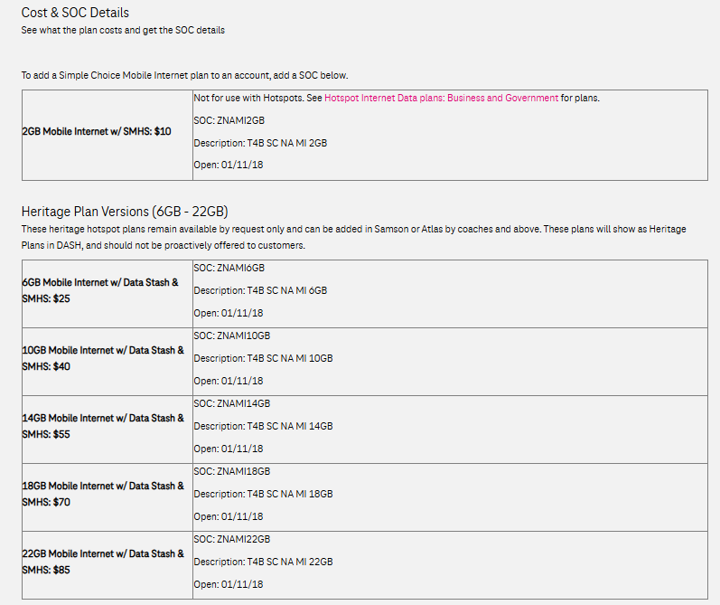
T-Mobile Mobile Internet
CONFIDENTIAL

